Slide 1


Difference Between Software and Hardware in ICT
Name: AjeebUllah
Roll No: 25F-CY-092

Slide 2
Introduction
In ICT, computers have two main parts: hardware and software. They work together to help computers perform tasks and produce results. Understanding their difference makes it easier to learn how computers work

Slide 3
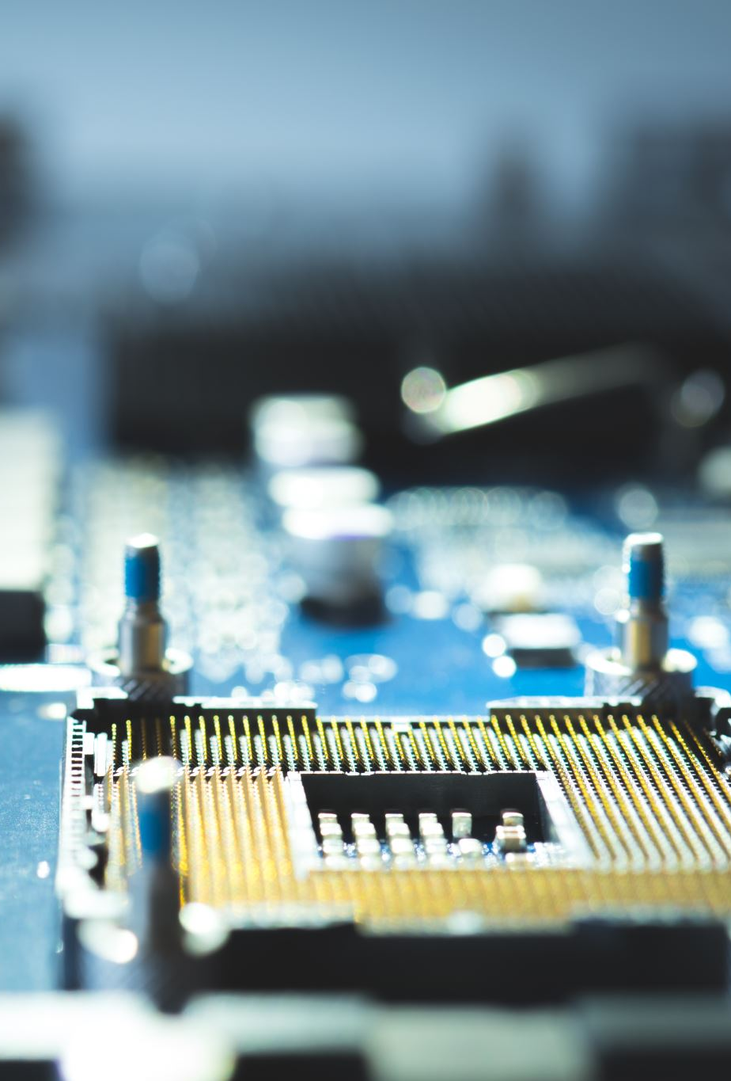
What is Hardware?
Hardware is the physical part of a computer that we can see and touch, such as the main body and connected devices.

Slide 4

What is Software?
Software is a set of programs and instructions that tell the computer what to do. It is not physical and works inside the computer.

Slide 5
4. Types of Hardware
Common types of hardware include:
Input devices: keyboard, mouse
Output devices: monitor, printer
Processing device: CPU
Storage devices: hard disk, USB

Slide 6
Types of Software
Main types of software are:
System software (Windows, Linux)
Application software (MS Word, browsers)
Utility software (antivirus)

Slide 7
Major Differences Between Hardware and Software
Hardware | Software
Physical components | Programs and instructions
Can be touched | Cannot be touched
Can get damaged | Can get corrupted
Needs software to work | Needs hardware to run

Slide 8
Role in ICT
Hardware provides the machine, and software controls how it works. Both are needed to complete tasks.

Slide 9
Examples
Hardware examples include keyboard, CPU, and monitor. Software examples include Windows and MS Word.

Slide 10
Conclusion
Hardware and software are both essential in ICT. Hardware is the physical part, while software gives instructions. A computer needs both to work properly.

